Slide 1
Selected Genetic Algorithms for Vehicle Routing Problem
Group 6
108062226 蘇志翔

Slide 2
Outlines
Term project introduction
Paper introduction
Preparation
Experiments
Results
Conclusion
Future works

Slide 3
Outlines
Term project introduction
Paper introduction
Preparation
Experiments
Results
Conclusion
Future works

Slide 4
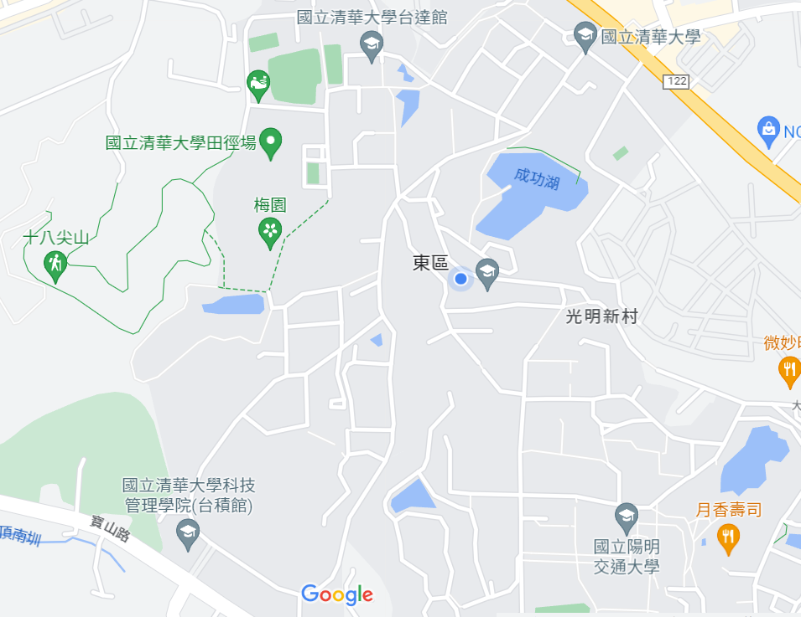
Motivation

Slide 5

Motivation

Slide 6
Motivation
Why this problem occurs?
Most of us go to the nearest station, such as GEN II or school gate
Most of us want to go to bus station 10 ~ 15 before classes.
Have time constraints.

Slide 7
Motivation
How to deal with this problem?
Add more bus to sent students => How much buses should be added?
Rearrange the path => How to rearrange?
Move the depot to other places rather than at the school gate => where?
Ask students to go to bus station at specified time => well….
Similar problem => Vehicle routing problem

Slide 8
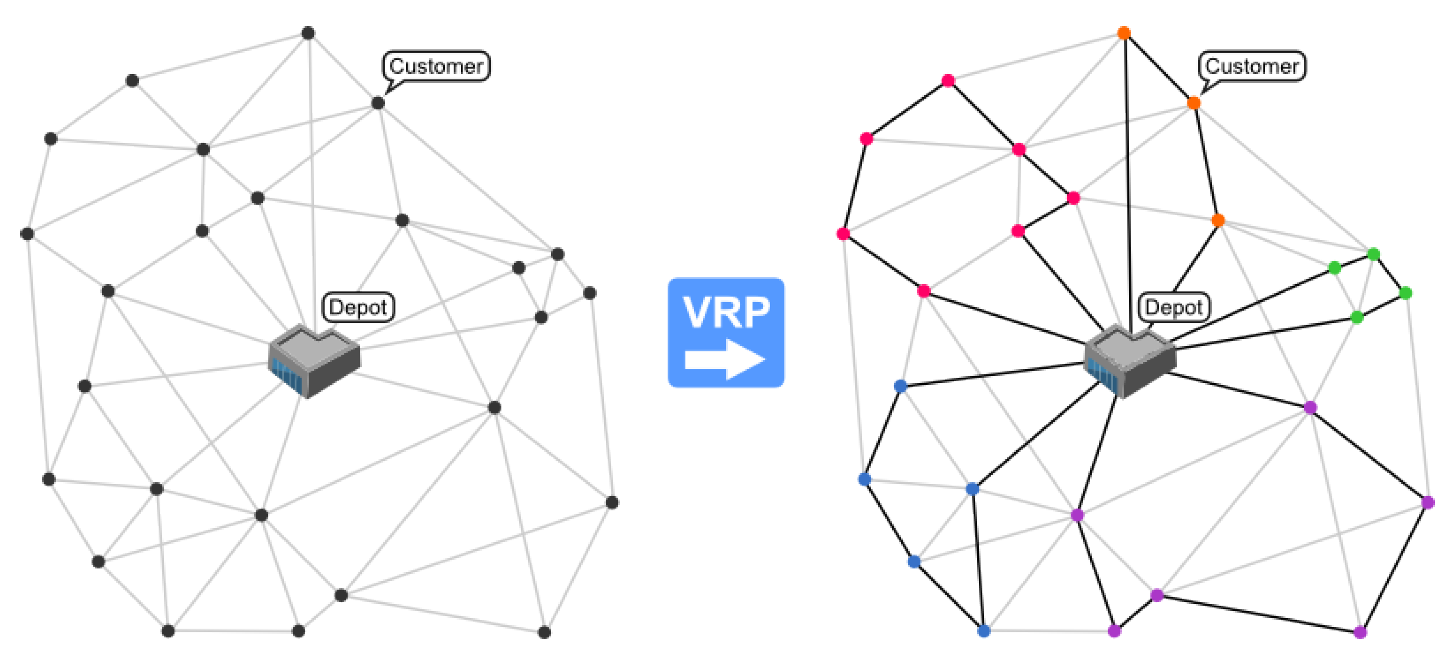
Vehicle routing problem (VRP)
Undirected graph with distance
1 or more depot
Multiple customers, every of which has its needs.
Multiple vehicles, each may varies from its capacity.
Source: https://www.mdpi.com/2079-9292/10/24/3147

Slide 9
Vehicle routing problem (VRP)
Goals: To find the paths (may have 1 or more) that satisfy all customers’ needs and maximize / minimize your requests.
Request example: Minimize the distance, minimize the car been used, etc.
Source: https://www.mdpi.com/2079-9292/10/24/3147

Slide 10
Characteristics
VRP is NP-hard (TSP can be derived into VRP in polynomial time).
Can be represented using permutation.
Needs some heuristic algorithm to get near-optimal solution.
=> Genetic Algorithm

Slide 11
Related works
VRP with time windows, VRPTW:
Customers have their deadline => time spent on serving the customers is also need to be in consideration.
GENEtic ROUting System (GENEROUS): the first implementation for VRPTW, which focuses on merging two vehicle routes into one.
Capacitated Vehicle Routing Problem (CVRP)
Capacity has limits.
Hybrid Vehicle Routing Problem
Including alternative delivery, pickup, and time window.

Slide 12
Outlines
Term project introduction
Paper introduction
Preparation
Experiments
Results
Conclusion
Future works

Slide 13
Information
Author: J. Ochelska-Mierzejewska, A. Poniszewska-Mara ´nda, W. Mara´nda
Journal: Electronics 2021, MDPI
Published date: December 17, 2021
Links: https://www.mdpi.com/2079-9292/10/24/3147

Slide 14
Points
Show the implementation of different GA operators and analyze the impact and participation through simulations of the selected problem.
Conduct the experiments to find an optimal solution for a large-scale real-life instance of the VRP.

Slide 15
Outlines
Term project introduction
Paper introduction
Preparation
Experiments
Results
Conclusion
Future works

Slide 16

Assumption
Every vehicle has the same capacity $c$
There is only one depot

Slide 17
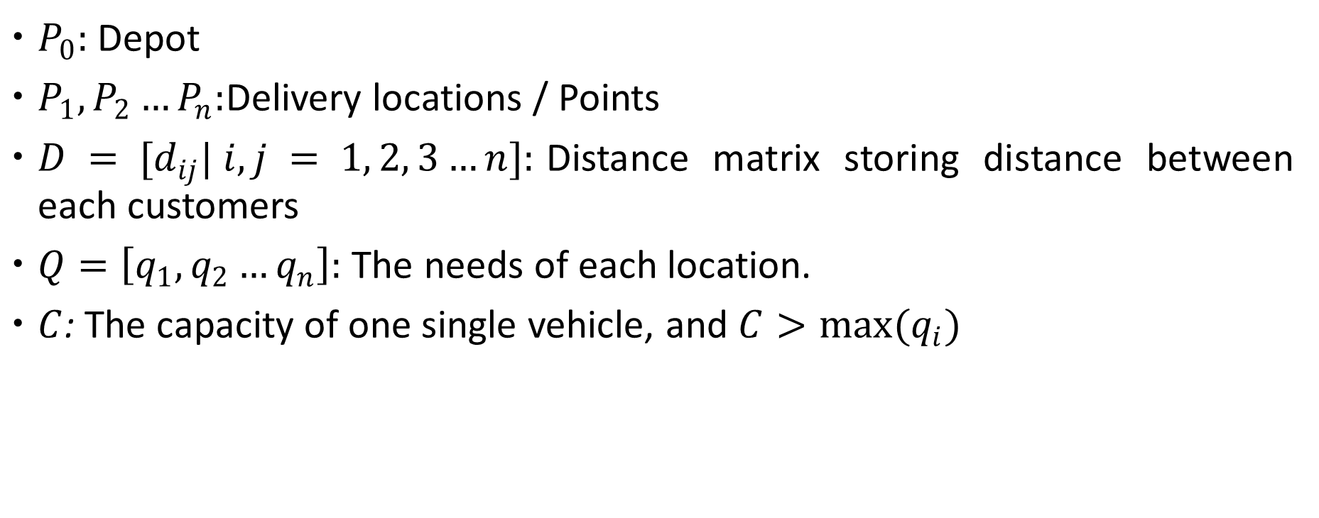
Mathematic modal
$P_{0}:$Depot
$P_{1},P_{2}…P_{n}:$Delivery locations / Points
$D = [d_{ij}| i, j = 1, 2, 3…n]:$Distance matrix storing distance between each customers
$Q=\left[q_{1},q_{2}…q_{n}\right]:$ The needs of each location.
$C$: The capacity of one single vehicle, and $C>max(q_{i})$

Slide 18
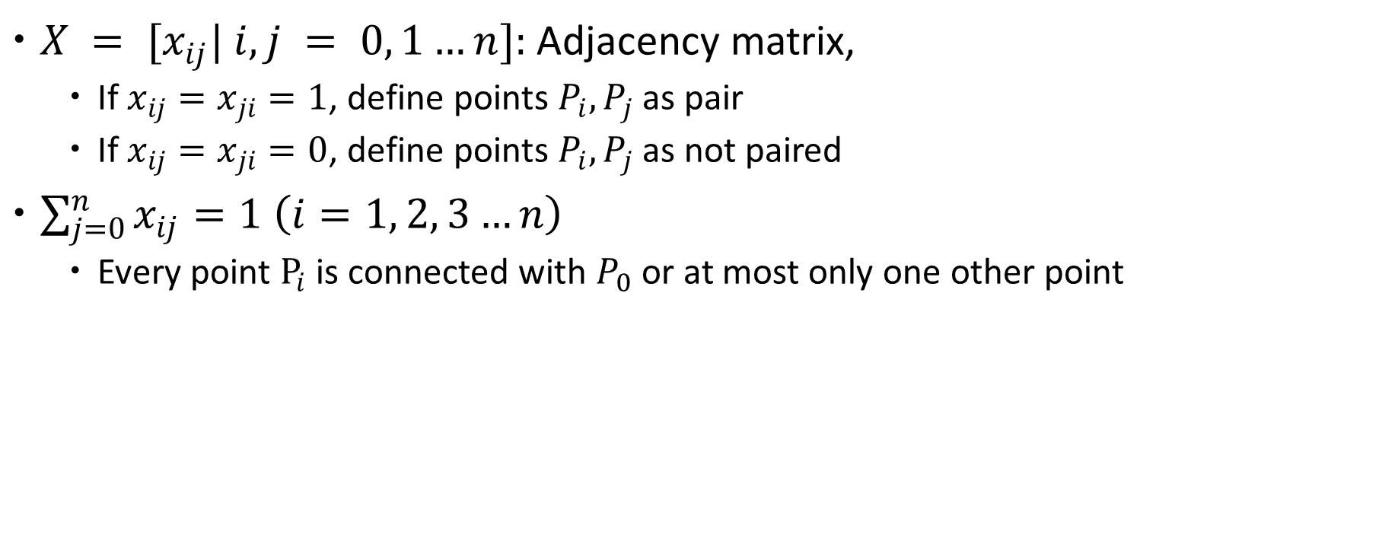
Mathematic modal
$X = [x_{ij}| i, j = 0, 1…n]:$Adjacency matrix,
If $x_{ij}=x_{ji}=1$, define points $P_{i},P_{j}$as pair
If $x_{ij}=x_{ji}=0$, define points $P_{i},P_{j}$as not paired
$\sum_{j=0}^{n}{x_{ij}}=1 \left(i=1, 2, 3…n\right)$
Every point $P_{i}$ is connected with $P_{0}$ or at most only one other point

Slide 19
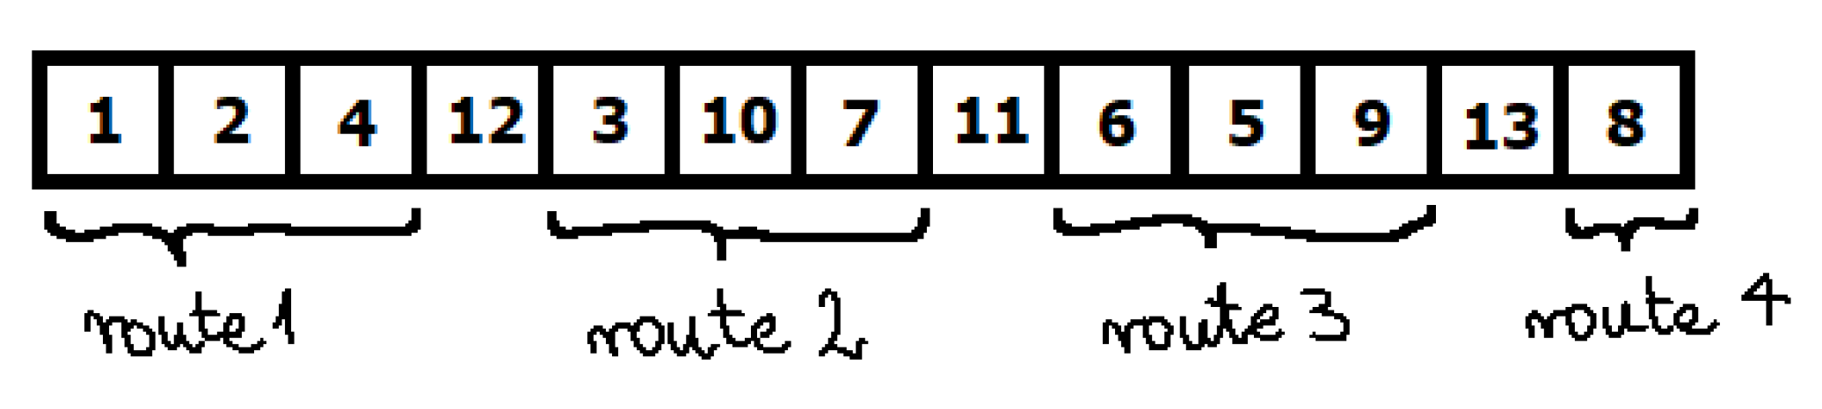
Representation
0: Represent the starting point(depot) in a graph (Can be skipped to increase readability)
1~n: Represent n customers.
n+1~m-1: Represent vehicles, where n+1 represent vehhicle 1…, m-1 represent vehicle m-n-1
Vehicle non-used can be removed from representation
But There are m-n vehicles => 1 vehicle is always skipped (default to use)
Source: https://www.mdpi.com/2079-9292/10/24/3147

Slide 20

Selection
Use $(μ, λ)$
Roulette wheel selection
Rank selection
Tournament selection
Elitism selection

Slide 21
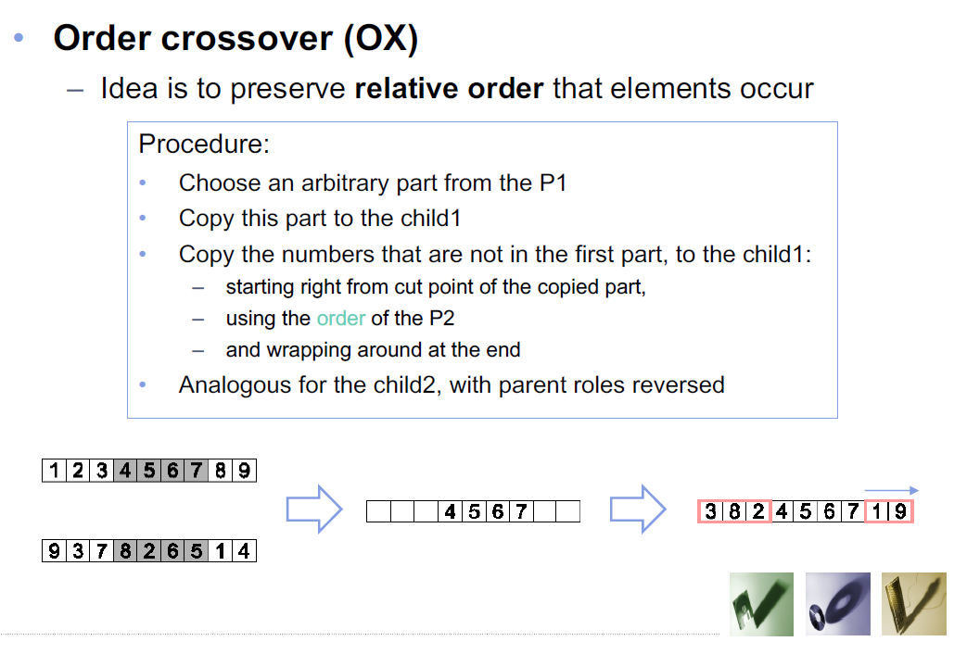
Crossover
Vertex-based crossover
Order Crossover (OX)
Cycle Crossover (CX)
Partially Mapped Crossover
Edge-based crossover
Alternative edge crossover
Edge Recombination

Slide 22
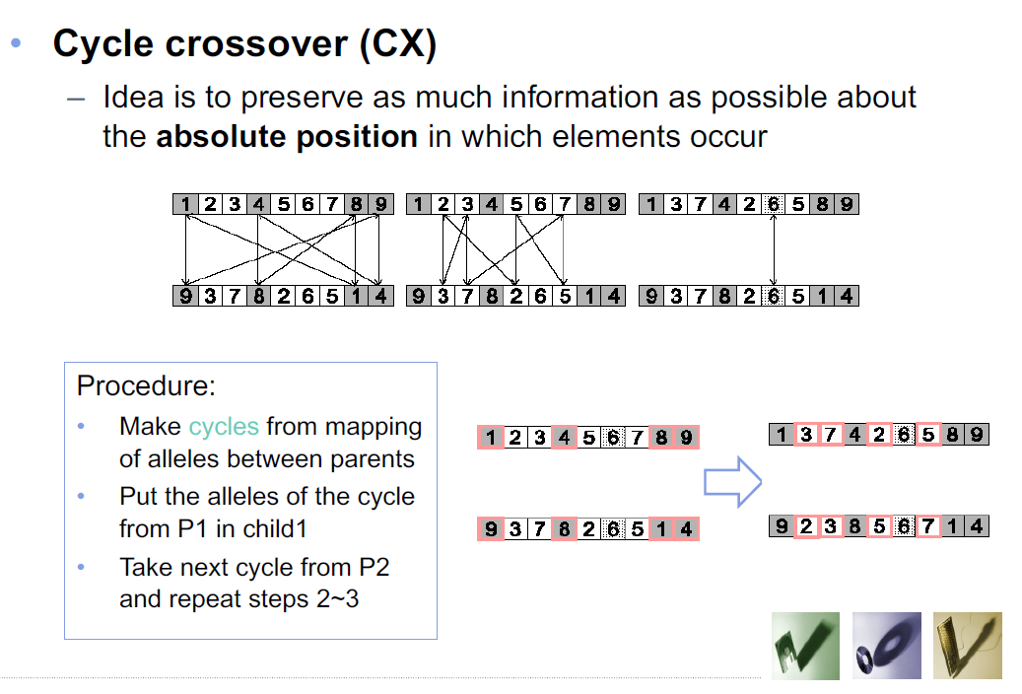
Crossover
Vertex-based crossover
Order Crossover (OX)
Cycle Crossover (CX)
Partially Mapped Crossover
Edge-based crossover
Alternative edge crossover
Edge Recombination

Slide 23
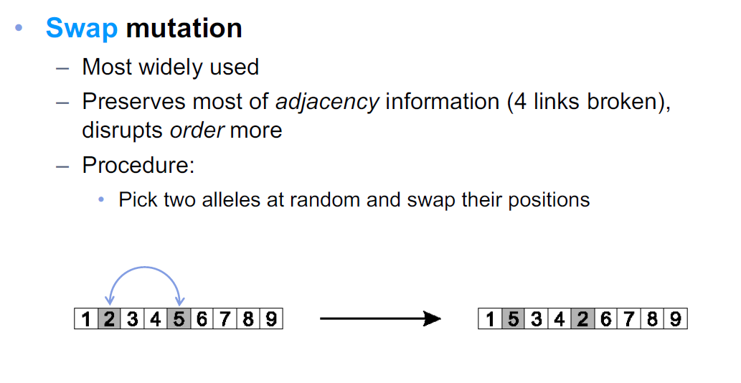
Mutation
Swap mutation - for simplicity
It is safe to swap vehicle number and customer number

Slide 24
Outlines
Term project introduction
Paper introduction
Preparation
Experiments
Results
Conclusion
Future works

Slide 25
Test instances
Test instances
Augerat Set A
Augerat Set B
Augerat Set P
Christofides and Eilon Set E
Fisher Set F
Customers are mostly around the depot, few of them are far away
Small amount of vehicles
TSPLIB converted Ulysses instances
Every instance run 3 times during experiment.

Slide 26
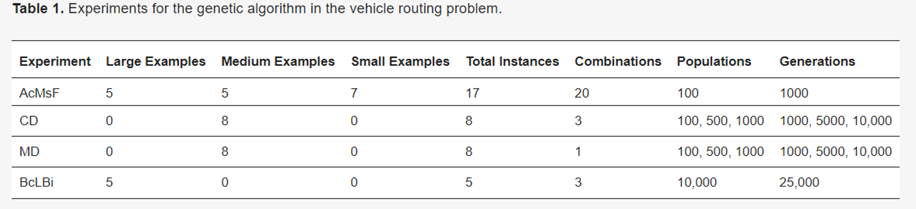
Experiments
All Combinations, Moderate Settings, Fast Experiment (AcMsF)
Crossover Domination Experiment (CD)
Mutation Domination Experiment (MD)
Best Combinations, Long, Large Examples Experiment (BcLBi)

Slide 27
Experiments
All Combinations, Moderate Settings, Fast Experiment (AcMsF)
Best Combinations, Long, Large Examples Experiment (BcLBi)

Slide 28

Fitness function
$v=\frac{f −o}{o} ∗100\%$
v is the score in percent
f is the best value in a single round by the GA
o is the global optimal solution, which is known in advance.
The lower, the better

Slide 29
Outlines
Term project introduction
Paper introduction
Preparation
Experiments
Results
Conclusion
Future works

Slide 30
All combinations, moderate settings, fast experiment
Population: 100
Generation: 1000
Mutation rate: 0.1
Crossover rate: 0.4
Operator types: 20
5 kinds of crossover * 4 kinds of selection

Slide 31
All combinations, moderate settings, fast experiment
Purpose: Reduce the computation time as much as possible while keeping the evolution competitive.
Dataset

Slide 32
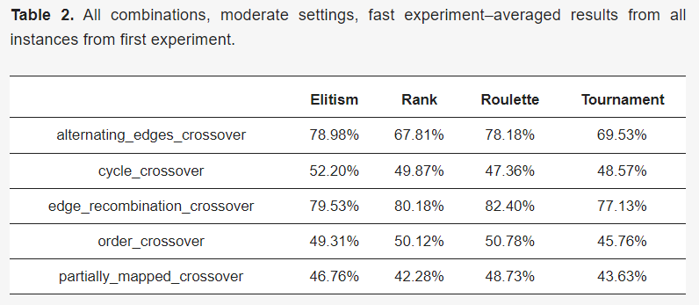
Crossover performance

Slide 33
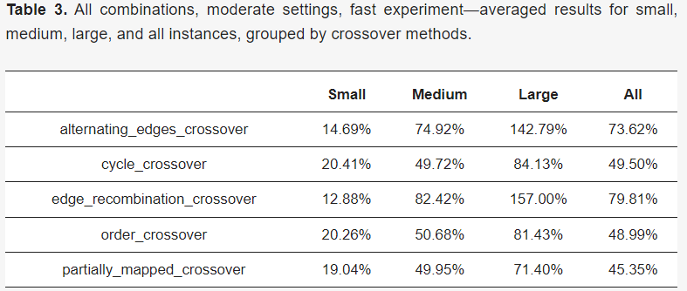
Crossover performance

Slide 34
Crossover performance
Edge-based crossover
Lower exploration
Higher exploitation
Vertex-based crossover
Higher exploration
Lower exploitation

Slide 35
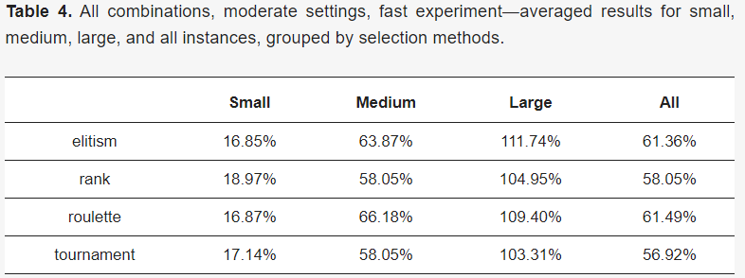
Selection performance

Slide 36
Best combinations, long, large examples experiment
Population: 1000
Generation: 10000
Mutation rate: 0.1
Crossover rate: 0.5
Operator types: 3 best result from previous experiments
alternating edges crossover with rank selection,
alternating edges crossover with tournament selection,
edge recombination crossover with tournament selection

Slide 37
Best combinations, long, large examples experiment
Purpose: Simulate the VRP in real world.
Dataset

Slide 38
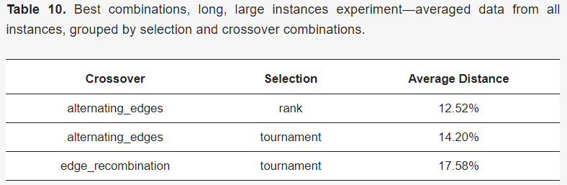
Result

Slide 39
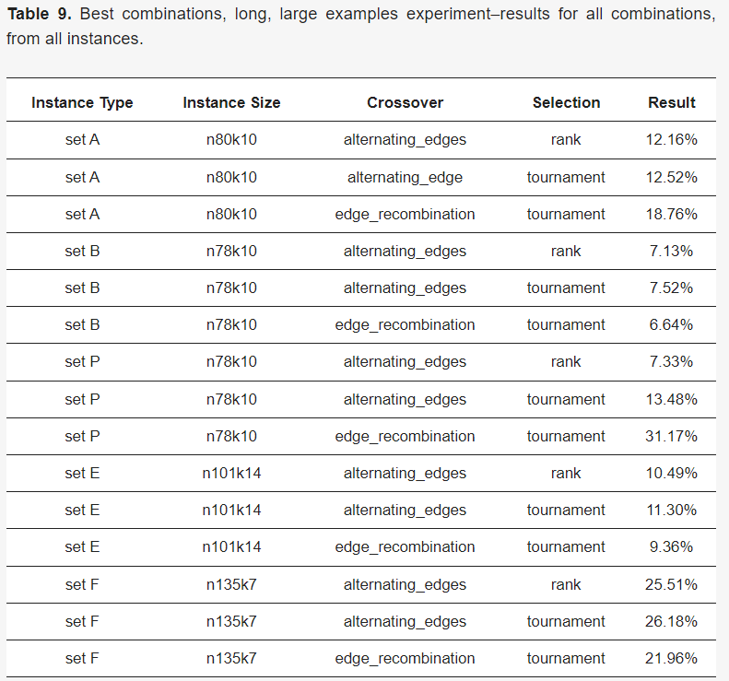
Result

Slide 40
Outlines
Term project introduction
Paper introduction
Preparation
Experiments
Results
Conclusion
Future works

Slide 41
Overall conclusion
Large domination for any operators has no positive for the final result.
Edge-based operator gets better result than vertex-based operator due to better exploitation.
Can combine GA with other metaheuristic method.

Slide 42
All combinations, moderate settings, fast experiment
Selection method does not seem to impact final results very much. If any selection method were to be chosen, tournament would be the one, as it provides slightly better results than rest.
The average solution is not optimal but not completely random.
Better results were obtained in case of smaller examples.
One thousand generations is definitely not enough for the GA to even start producing non-random solutions for larger examples.
Despite harsh conditions for the algorithm, it was still able to find a very optimal solution for one of the examples.

Slide 43
Best combinations, long, large examples experiment
Reasonably chosen genetic algorithm parameters can provide enough stability to start reaching satisfying results even for large examples.
Real life instances pose greater difficulties compared to randomly distributed ones.
Given enough time and computational power, genetic algorithm implementation can produce competitive results even in the largest known test instances.
Optimizations of paths in areas with higher density is easier and appears earlier in the whole optimization process than optimization of routes leading to further points of interest.
Alternating edges crossover combined with rank selection is the most stable choice for genetic operators, capable of finding results comparable with the worldwide best-known ones.

Slide 44
Outlines
Term project introduction
Paper introduction
Preparation
Experiments
Results
Conclusion
Future works

Slide 45
Future works
Convert NTHU bus problem into VRP
Further works

Slide 46
Convert NTHU bus problem into VRP
Define there are 1 depot and 13 customers
Define the needs of each customer = the number of students that want to get off there.
TSMC: Estimate it through the class there in
Define D to be the distance matrix
Fitness function
Minimize the time spent => minimize the vehicles used
May change the depot to GEN II station to get better result

Slide 47
Convert NTHU bus problem into VRP
Use edge crossover with tournament selection to get best result
Make population size and generation bigger to get better result
But not so big, since NTHU bus problem isn’t a large example

Slide 48
Further works
Need to have time constraints
=> VRP with time window
1 depot isn’t realistic, make every customer a depot
=> multi depot VRP

Slide 49
Thanks for listening!

